Slide 1
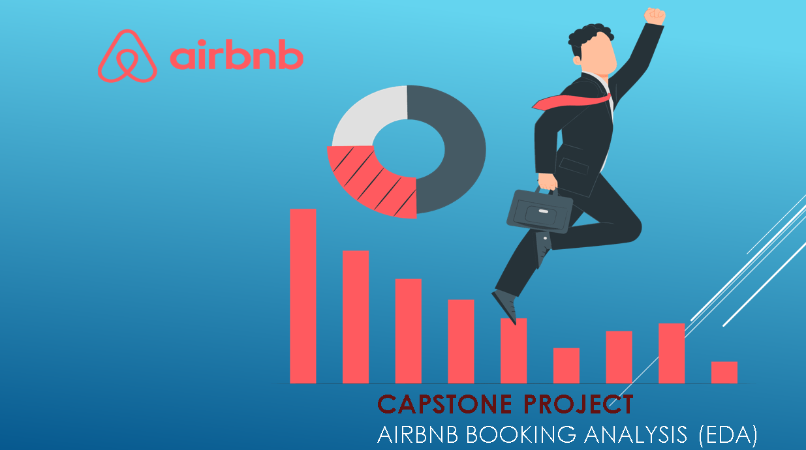

Slide 2
Table of content 1. Project summary of the Airbnb Dataset 2. Data summary and variables 3. Exploratory data analysis 4. A solution to business objective 5. Conclusion

Slide 3
Project summary • Since its inception in 2008, Airbnb has revolutionized the travel industry by providing a unique and personalized way for guests to experience the world. Today, Airbnb is a globally recognized service, catering to millions of users. The platform's vast database, consisting of millions of listings, is a goldmine for data analysis. Analyzing this data is crucial for enhancing security, making informed business decisions, understanding customers and host behavior, improving performance, guiding marketing initiatives, and we are implementing innovative services. • The dataset in question comprises approximately 49,000 observations with 16 columns, containing a mix of categorical and numeric values. This dataset offers a comprehensive view of Airbnb listings, which can be leveraged to gain valuable insights into various aspects of the platform's operations and user interactions.

Slide 4
Dataset summary • Airbnb data 1. Categorical columns 3.Unique columns • Name • Id • Host id • Host name • Neighbourhood • Neighbourhood Group • Room type 2. Numerical columns 4. Date Time • Latitude • Last review • Longitude • Price • Minimum night • Number of reviews • Reviews per month • Calculated host listing count • Availability 365 days

Slide 5
Understand the variables ID: • It’s a unique ID for a House/apartment. Name: • Name of the listing House/apartment. Host id: • Host ID is the government-approved ID for each individual who rents their properties on Airbnb. Host Name: • Host names are the name of the individual or organization Who owns a room/apartment on Airbnb website. Neighborhood groups: • Neighborhood groups are the cluster of neighborhoods in the area. • There are about 5 boroughs in the state. Neighborhood: • When searching for accommodations in a city, guests can filter by neighborhood attributes and explore layers of professional-quality content, including neighborhood maps, custom local photography, and localized editorial, public transportation and parking details, and tips from Airbnb’s host community. Latitude: • Latitude is the measurement of distance north or south of the Equator. Longitude: • Longitude is the measurement east or west of the prime meridian.

Slide 6
Room type: • Airbnb has 3 categories for types of space : * Entire House/Apartment * Private room * Shared room  Price ($): • The total price ($) of Airbnb reservation is based on the rate set by the Host, plus fee or costs determined by either the Host or Airbnb.  Minimum nights: • Minimum nights criteria for booking that guest have to pay for book that House/room or apartment. *Number_of_reviews: • Number of review of each host submitted by guest.  Last review: • Latest review submitted by guest as a feedback.  Reviews per month: • Number of review Host get per month.  calculated_host_listings_count: • Amount of listing per host.  Availability 365 Days: • It is an indicator of the total number of days the listing is available for during the year

Slide 7
Exploratory Data Analysis:
What is EDA ?
• “Exploratory Data Analysis “ is very important in machine learning. Whenever we start our work on any project we must analyze the factors deeply. Hypothetical questions and that hypothetical questions lead to some hidden facts. This collaborative work is simply known as EDA.
The following steps are involved in the process of EDA:
Acquire and loading data
Understanding the variables
Cleaning dataset
Exploring and Visualizing Data
Analyzing relationship between variables

Slide 8
Approach used for EDA:
• The approach we have used in this project is defined in the given format.
Loading our data:- In this section we just loaded our dataset in colab notebook and read the csv file.
Data Cleaning and Processing:- In this section we have tried to remove the null values and for some of the columns we have replaced the null values with the appropriate values with reasonable assumptions.
Analysis and visualization:- In this section we have tried to explore all variables which can play an important role for the analysis. In the next parts we have tried to explore the effect of one over the other. In the next part we tried to answers our hypothetical questions.
Future scope of Further Analysis:- There are many apartments having availability as 0, which means they might stopped their business, we can find the relation of neighborhood with these apartments if we dig deeply, various micro trends could be unearthed, which we are not able to cover during this short duration efficiently. There are various columns which can play an important role in further analysis such as number of reviews and reviews per month finding its relation with other factors or other grouped factors can play an important role.

Slide 9
Graphs used for EDA:
Types of Graphs we have used for Data Visualization:
Count Plot
Histogram
Bar Plot
Sub plot
Scatter Plot
Pie chart
Heat map
Pair plot
Box plot

Slide 10
Libraries used for EDA:
Python Libraries we used for graphs:
Matplotlib
Seaborn
Numpy
Matplotlip.pyplot
Pandas

Slide 11
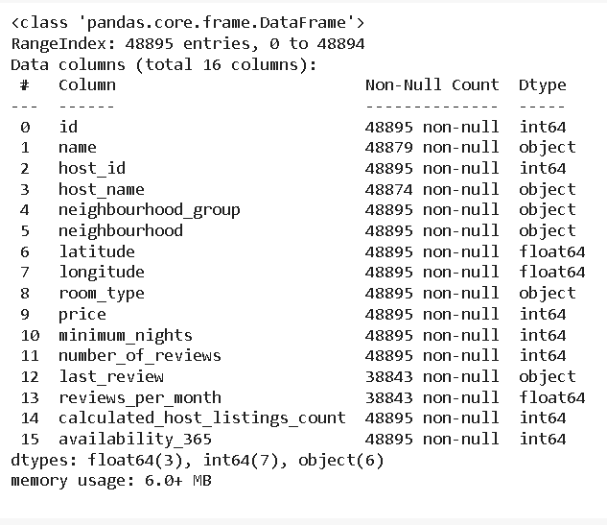
Data Wrangling: * Let’s check the null values in the data set. • Replaced non-value of column name and host_name with “unknown”. • Deleted columns last_review and reviews_per_month because it contain high null values of around 10000. • created a subset of data data as data_review to analyze review-related features separately. • created a new features "days_since_last_review" in data_review using last review column
Column null values
1. name 10
2. host_name 21
3. last_review 10052
4. reviews_per_month 10052

Slide 12
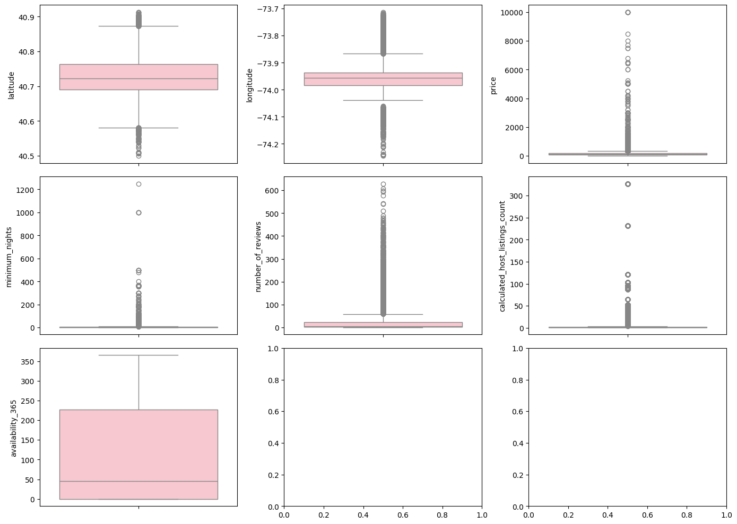
1. Display the distribution of data based on a five-number summary using Box plot for numerical variable

Slide 13
Insight(s) found from the chart
• This provide a visual summary of the data, highlighting the median, quartiles, and potential outliers.
• By removing outliers we cleaned the data with correct range of values so that while finding the insights like average value , it will give correct value and not bias towards outliers.

Slide 14
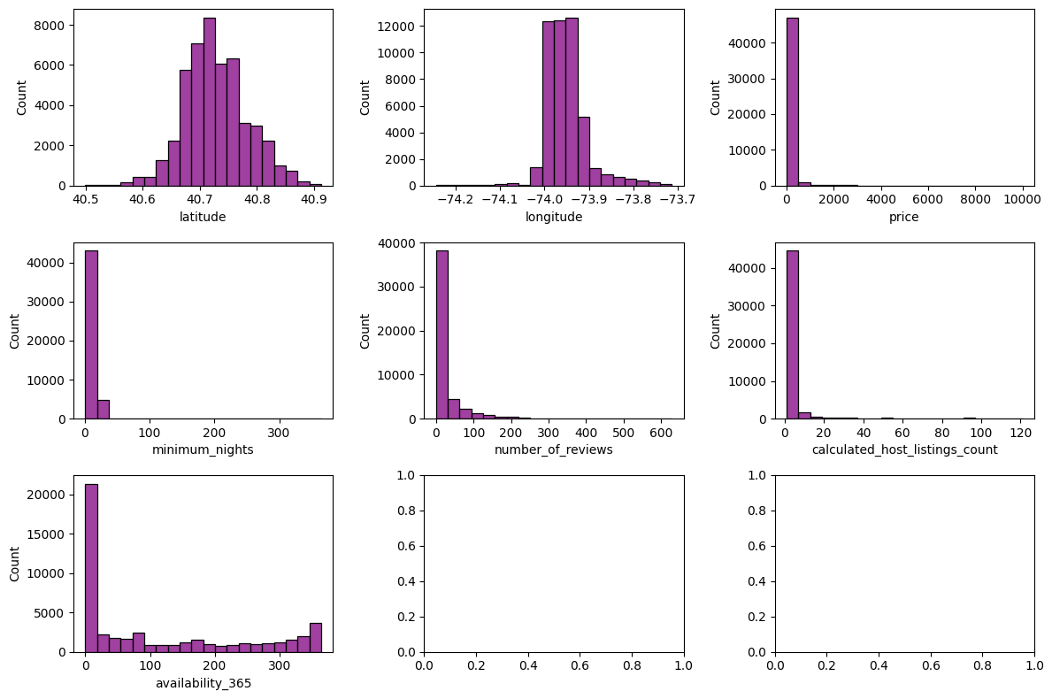
2. Visualise the distribution of dataset using Histogram plot

Slide 15
Insight(s) found from the chart
• Most of the data in our dataset is from a particular region and its not distributed evenly across all region given in the dataset.
• Price of most of the hotels are between 0 to 500 , but there are some exceptional cases also.
• Although all hotels are available throughout the year but there are some hotels also which are available for only around 20 days which may be seasonal bookings like summer vacations.

Slide 16
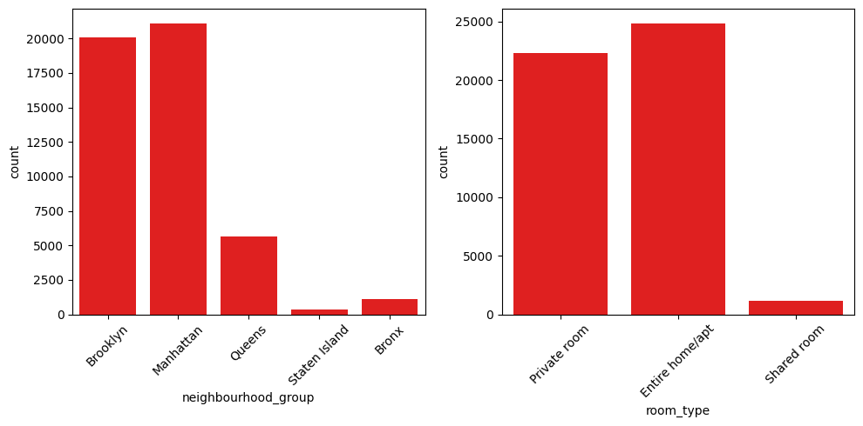
3. Represent the frequency of categorical variables using barplot
Insight(s) found from the chart
In neighbourhood group manhattan has highest number of counts and staten island has lowest number of count.
most number of bookings are happening in entire home/apt, whereas least number of bookings are happening in shared room.

Slide 17
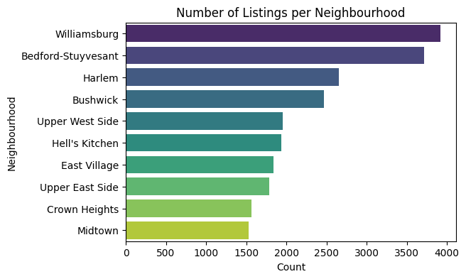
4. Top 10 neighbourhood

Slide 18
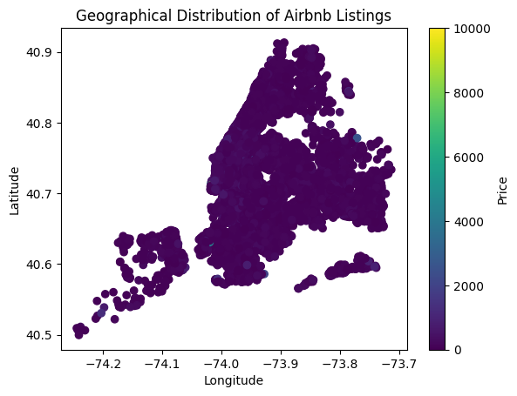
5. Geographical location of the hotels located using scatter plot Insight(s) found from the chart * Most of the hotels are located in a particular region.

Slide 19
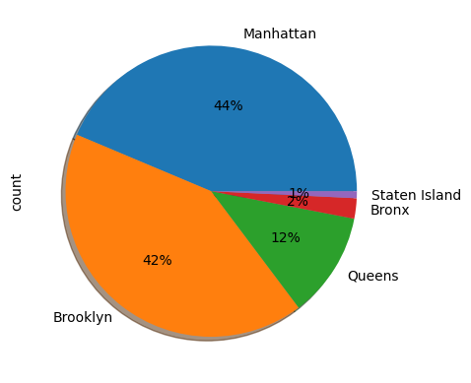
6.To see the distribution of neighbourhood_group.we plot pie chart
Insight(s) found from the chart
* The highest percentage of neighbourhood group is of manhattan (44%).
* the lowest percentage of neighbourhood group is of staten island (1%).

Slide 20
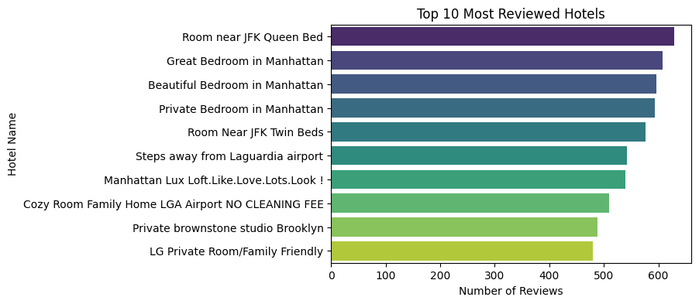
7.Top 10 hotels based on number of reviews
Insight(s) found from the chart
* Room near JFK queen bed is most reviewed hotel.

Slide 21
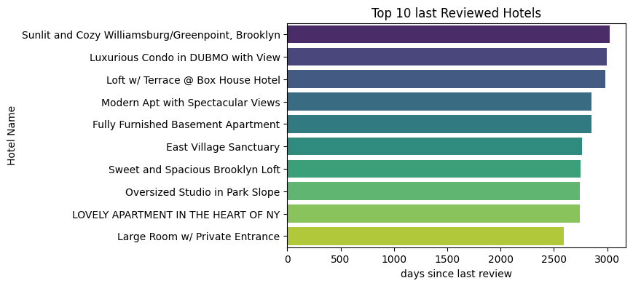
8.Hotels can be unlisted from Airbnb because they are not reviewed almost since a decade

Slide 22
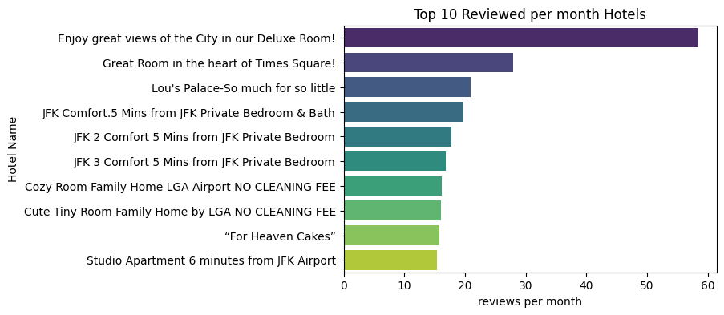
Top 10 reviewed per month hotels

Slide 23
Hotel price analysis
After Removing hotels with zero prices
• the average per night price of the hotel is 151.35
• the minimum per night price of the hotel is 10
• the maximum per night price of the hotel is 10000
• 75 percentile value is 175 but maximum price is 10000 that means there is some values which is exceptional or outlier

Slide 24
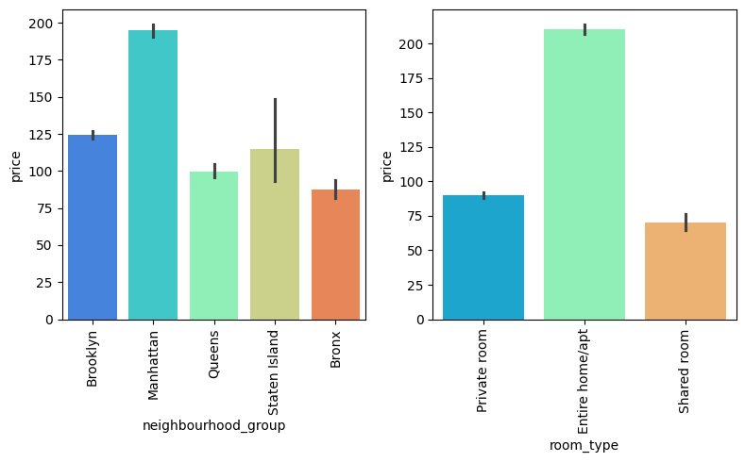
To see the price distribution of hotels with neighborhood group and room type . We plot subplot
Insight(s) found from the chart
Average price of room type entire home /apartment is high and shared room average price is low
Average price of neighbourhood_group Manhattan is high and Bronx average price is low

Slide 25
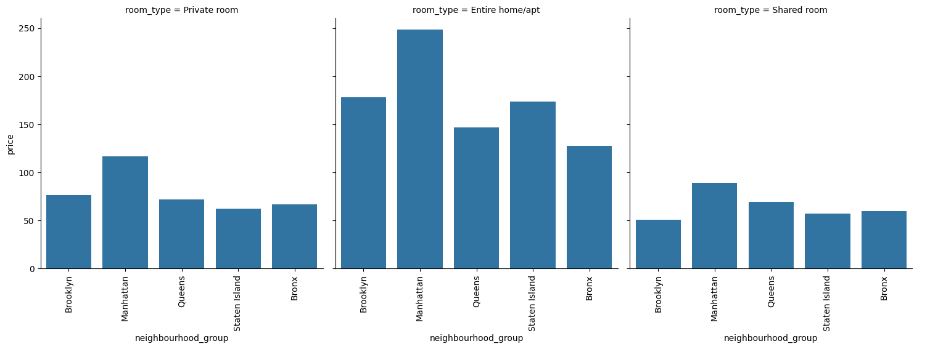
To see the distruibuton price for each neighbourhood group of each room type. We plot bar plot.
Insight(s) found from the chart
Distruibuton price for each neighbourhood group of each room type is similar except for entire home and apartment where the price of staten island is more as compare to queens and bronx

Slide 26
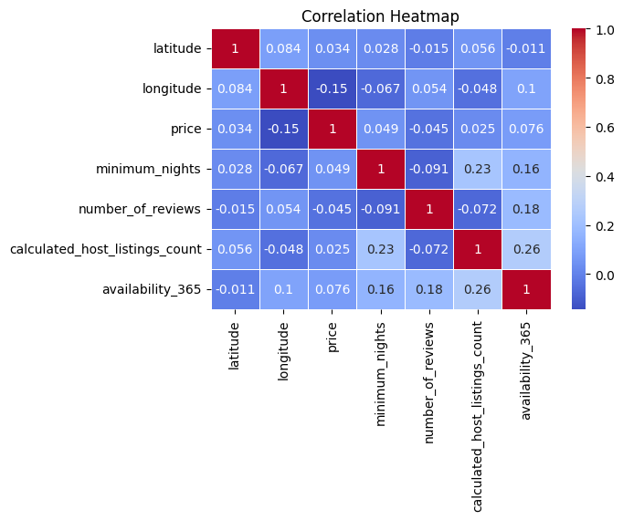
To see the correlation between each variable. We plot correlation heatmap

Slide 27
Insight(s) found from the chart
• * Latitude and Longitude:
• Latitude and longitude have a small positive correlation (0.084). This suggests that there is a slight relationship between these two geographical coordinates, but it is not strong. Price Correlations:
• * Price has a negative correlation with longitude (-0.15), indicating that as longitude increases, the price tends to decrease slightly. Price has a very weak positive correlation with minimum nights (0.049), availability 365 (0.076), calculated host listings count (0.025), and latitude (0.034). These correlations are very weak, indicating that price is not strongly influenced by these variables. Minimum Nights:
• * Minimum nights has a moderate positive correlation with calculated host listings count (0.23) and availability 365 (0.16). This suggests that listings that require a higher minimum number of nights are more likely to have more listings by the same host and be available throughout the year. Number of Reviews:
• * Number of reviews has weak correlations with other variables. It has a weak positive correlation with longitude (0.054) and availability 365 (0.18), and a weak negative correlation with minimum nights (-0.091). Calculated Host Listings Count:
• * This variable has a weak negative correlation with longitude (-0.048) and a weak positive correlation with availability 365 (0.26). This suggests that hosts with more listings tend to have properties that are more available throughout the year. Availability 365:
• * Availability 365 shows the highest positive correlation with calculated host listings count (0.26), indicating that properties that are available more days in a year are likely to belong to hosts with multiple listings.

Slide 28
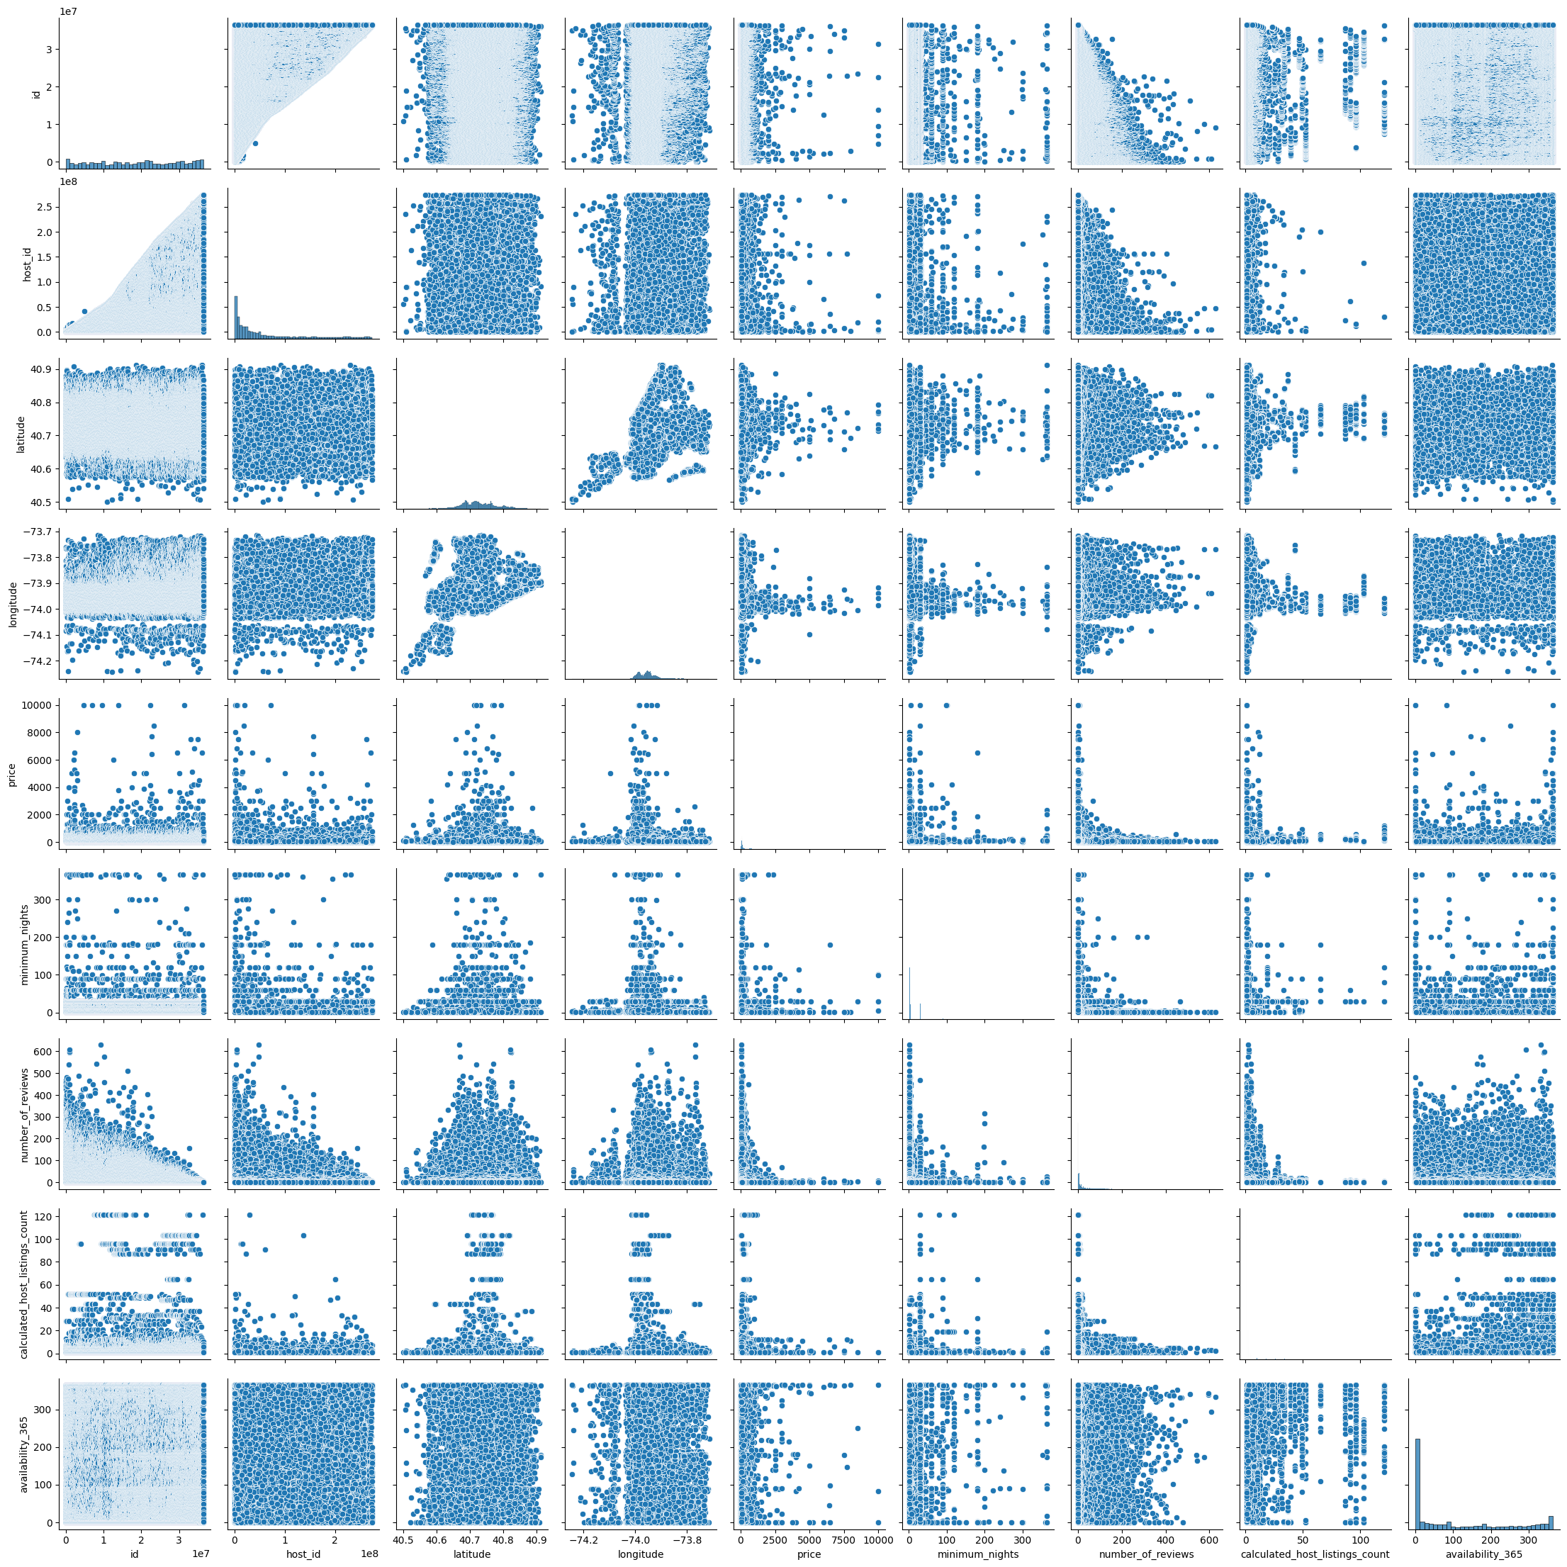
To see the distribution between each variables. We plot a pair plot.
There is no any such strong correlation between any features

Slide 29
Solution to Business Objective
• 1. Price Optimization:
• Analyze and adjust pricing strategies to optimize revenue. Focus on the most frequent price range (0-500) while considering exceptional cases for premium pricing.
• Implement dynamic pricing models for hotels available only seasonally (e.g., summer vacation bookings).
• 2. Market Expansion and Distribution:
• Address the uneven distribution of hotels across different regions. Strategically increase the presence in regions with lower counts, like Staten Island, to balance market coverage.
• Increase marketing efforts in regions with lower hotel counts to attract more bookings.
• 3. Room Type Strategy:
• Leverage the high demand for entire home/apartment bookings by expanding the inventory in this category.
• Develop targeted marketing campaigns to increase the bookings for shared rooms, which currently have the least number of bookings.
• 4. Location-Based Pricing Strategy:
• Capitalize on the high average prices in Manhattan by offering premium services and amenities to justify higher rates.
• Explore competitive pricing strategies in regions like Bronx where the average price is lower.
• 5. Enhancing Reviews and Ratings:
• Encourage guest reviews, especially for high-demand hotels like the one near JFK with the queen bed, to maintain and enhance reputation and visibility.
• 6. Correlation Insights:
• *. Utilize the correlation data to understand the factors influencing pricing and availability. For example, use the positive correlation between minimum nights and calculated host listings count to encourage longer stays for multi-listing hosts.

Slide 30
Conclusion
• From the data analysis, several key insights have emerged:
• 1. Price and Outliers:
• By removing outliers, we achieved a more accurate and unbiased average price, enhancing the reliability of our insights.
• 2. Regional Distribution:
• The majority of hotel data comes from a specific region, highlighting an opportunity to expand and diversify our geographical presence.
• 3. Seasonal Availability:
• Some hotels are only available seasonally, suggesting a potential for optimizing revenue during peak seasons.
• 4. Booking Preferences:
• Entire home/apartment bookings dominate, indicating a preference that can be leveraged for business growth.
• 5. Regional Price Variations:
• Manhattan has the highest percentage of listings and the highest average prices, while Staten Island has the lowest. This points to potential market expansion and pricing strategy adjustments.
• 6. Review Trends:
• The most reviewed hotel is a key asset, and encouraging more reviews can enhance overall business visibility and credibility.
• 7. Correlation Analysis:
• The correlations between various factors such as price, longitude, and availability provide insights for refining pricing and availability strategies. For instance, the slight negative correlation between price and longitude suggests potential for pricing adjustments based on location.
• By aligning our business strategies with these insights, we can optimize revenue, improve market coverage, and enhance customer satisfaction.

Slide 31
Thank You Project By Nishith Sharma

